Slide 1
Water contaminated with Didymosphenia geminata alters fish cell line viability
Pamela Olivares1, Matías Peredo-Parada3,4, Ian Scott1,Viviana Chavez5 Erico Carmona2,
Allisson Astuya6 & Jorge Parodi1*
A
Notes:
Figure 1. Biomolecules from D. geminate extract In A, example of chromatography from HPLC system from 5 different rivers.The insert show a table with value of peak and retention time, copared form the 5 different rivers contaminated with D. geminata

Slide 2
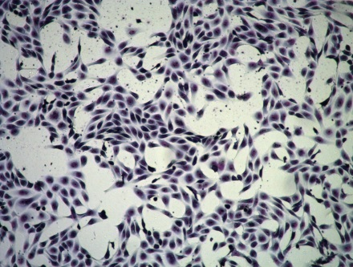
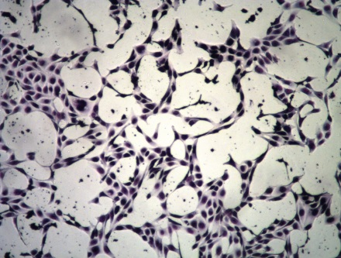
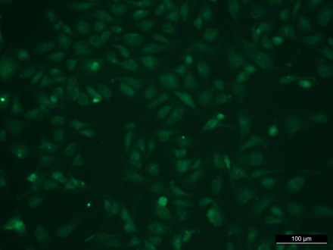
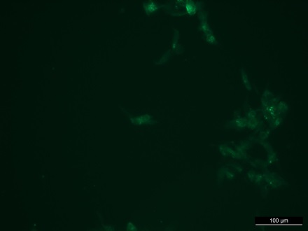
A
control
0,01 Didymo
control
0,01 Didymo
B
C
Notes:
Figure 2. Effect on CHSE-214 cell line In A, example of microphotographs in control, and exposed to water contaminated with D. geminata 0,01 V/V for 24 hrs Upper panel, show panoptic taning. Lower panel show alexa 488 phalodin staning. B, Cells viability, by MTT in a curve concentration of water for river or water contaminated with D. geminata. C Cells viability, by MTT in a curve concentration extract polyphenols from D. geminata. . The microphotographs are representative of the 5 independent observations. Each r point represents (mean ± SEM), la measurements of at least 5 independent culture and experiments.

Slide 3
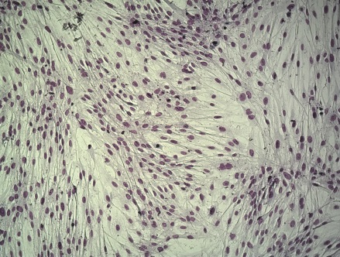
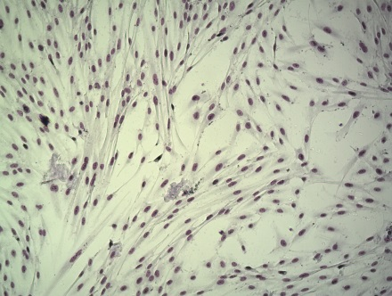
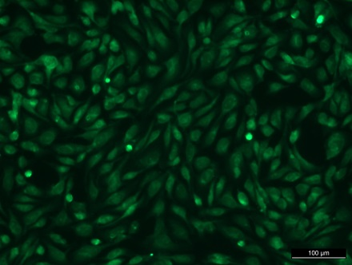
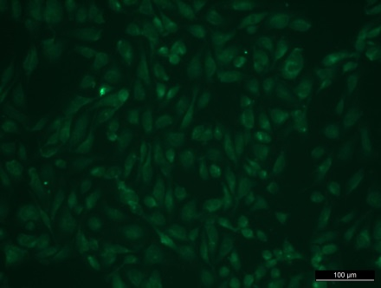
A
Control
0,01 Didymo
Control
0,01 Didymo
B
C
Notes:
Figure 3. Effect on SHK-1 cell line In A, example of microphotographs in control, and exposed to water contaminated with D. geminata 0,01 V/V for 24 hrs Upper panel, show panoptic taning. Lower panel show alexa 488 phalodin staning. B, Cells viability, by MTT in a curve concentration of water for river or water contaminated with D. geminata. C Cells viability, by MTT in a curve concentration extract polyphenols from D. geminata. . The microphotographs are representative of the 5 independent observations. Each r point represents (mean ± SEM), la measurements of at least 5 independent culture and experiments.

Slide 4
A
B
Notes:
Figure 4. Effect on viability and proliferation of cell line In A, example of microphotographs in control, and exposed to water contaminated with D. geminata 0,01 V/V for 24 hrs Upper panel, show panoptic taning. Lower panel show alexa 488 phalodin staning. B, Cells viability, by MTT in a curve concentration of water for river or water contaminated with D. geminata. C Cells viability, by MTT in a curve concentration extract polyphenols from D. geminata. . The microphotographs are representative of the 5 independent observations. Each r point represents (mean ± SEM), la measurements of at least 5 independent culture and experiments.

