Slide 1
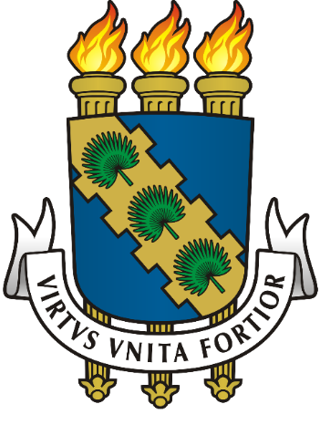
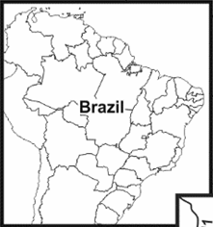
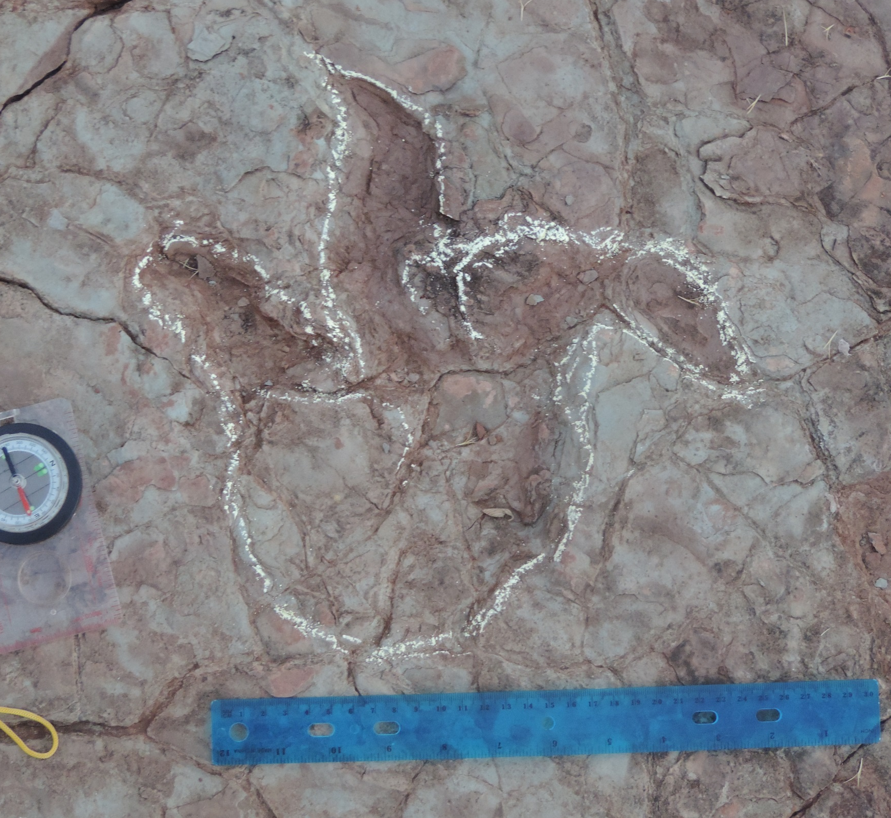
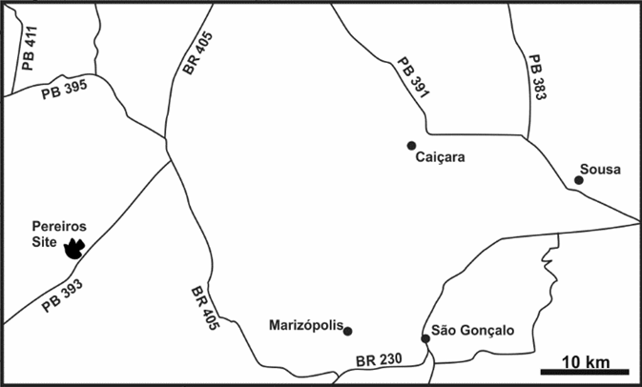
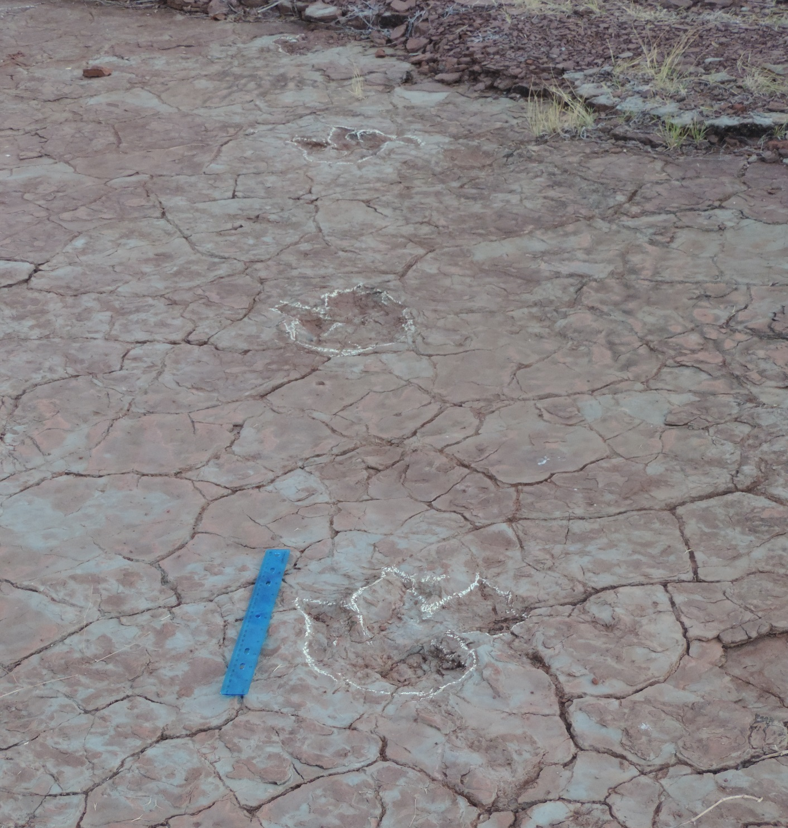
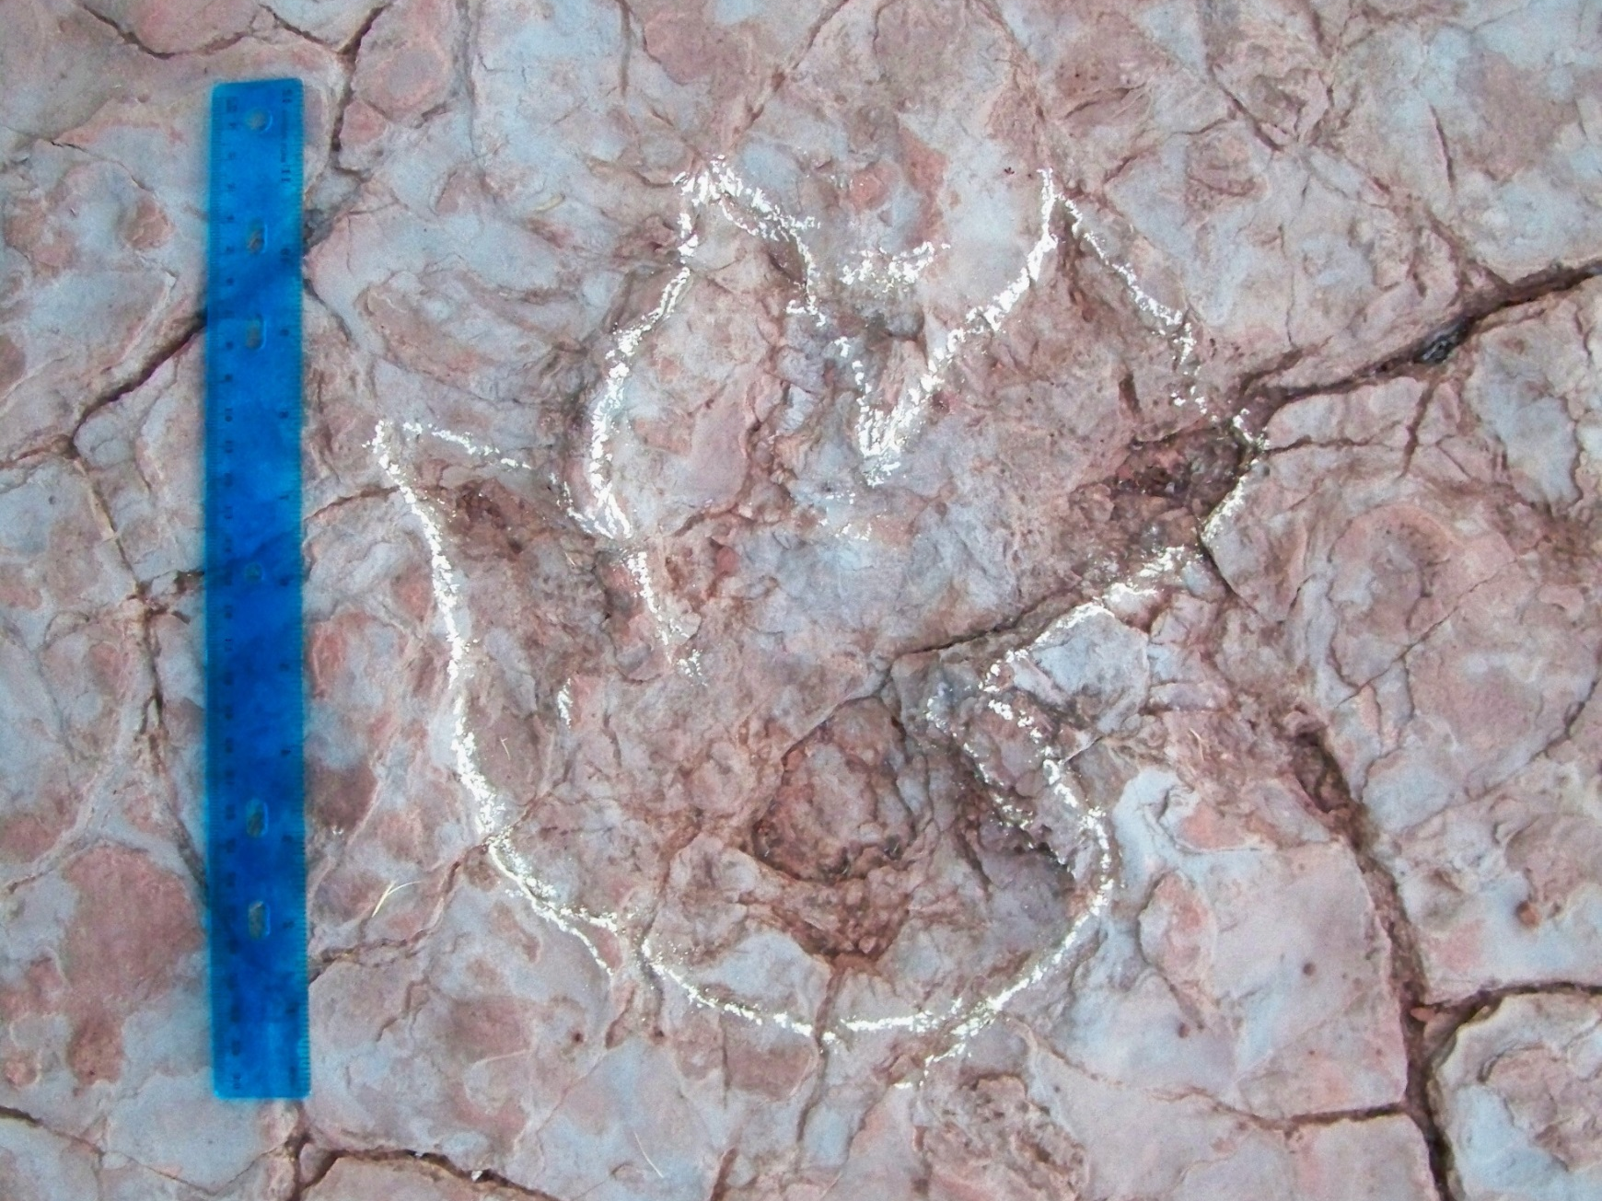
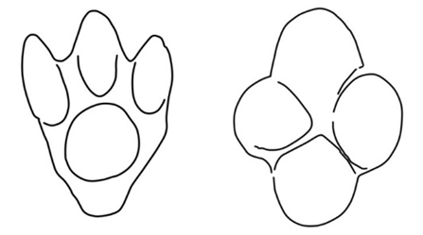
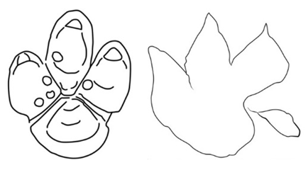
A NEW DINOSAUR TRACKSITE FROM THE EARLY CRETACEOUS SOUSA FORMATION OF BRAZIL
Hebert Bruno N. Campos¹; Niels Bonde²; Maria E. C. Leal³, Mário A. T. Dantas⁴, & Nicholas M. Gardner⁵
¹Rua Santo Antônio, 169, Santo Antônio, Campina Grande, PB, 58406-025, Brazil, email@hebertbrunocampos.com
²Zoological Museum (SNM), Universitetsparken 15, 2100 and Fur Museum, 7884, Copenhagen Ø, Denmark
³Departamento de Geologia, UFC, Campus do Pici, Bloco 912, 60455-760 Fortaleza, CE, Brazil
⁴Inst. Multidiscip. em Saúde, UFBA, Campus Anísio Teixeira, 45028-500, Vitória da Conquista, Bahia, Brazil
⁵Potomac State College of WVU, Keyser, WV 26726, United States of America
Abstract
b
A preliminary description of a new dinosaur tracksite from the Early Cretaceous (Barremian?) Sousa Formation of northeastern Brazil is presented. Pereiros presents ornithopod and theropod tracks and add new information about the morphological variability of dinosaur ichnocoenoses during the Early Cretaceous of Brazil.
a
Figure 1. Map of the Pereiros ichnosite locality.
Figure 2. Ornithopod tracks at the Pereiros ichnosite. Scale bar = 300 mm. (a) Ornithopod trackway. Tracks of Iguanodontipodidae indet. (b) SOPE I-1, (c) SOPE I-3. SOPE; SO = Sousa Formation; PE = Pereiros.
c
Figure 2. Ornithopod track. Scale bar = 300 mm.
Introduction
The Sousa Formation contains the richest dinosaur ichnofauna from the Early Cretaceous Rio do Peixe Basin, Northeastern Brazil. Occurs eventually ornithopod tracks, that are found also in the Antenor Navarro and Piranhas Formations. Together with one trackway from the Botucatu Formation, some isolated tracks from the Cenomanian São Luís Basin, and some trackways from the Early Cretaceous Corda Formation, at the moment, these occurrences indicates the only definitive presence of ornithopods in the Mesozoic of Brazil. In 2015, we explored the Sousa Formation for new ichnosites and potential dinosaur tracks.
a
b
c
d
Figure 4. Theropod track (SOPE III) from the Pereiros ichnosite referred to Irenesauripus. Scale bar = 300 mm.
Figure 3. Ornithopod pes tracks from Rio do Peixe basin:
(a) Sousaichnium pricei, (b) Staurichnium diogenis, (c) Caririchnium magnificum, and (d) Iguanodontipodidae indet. Tracks a and b redrawn from Leonardi (1979), and track c redrawn from Leonardi (1984).
Description
Comparisons
The studied area (Fig. 1) is localized at the municipality of São João do Rio do Peixe, in the upper part of the Sousa Formation, west of the Sousa Basin.
The Pereiros ichnosite represents a new occurrence of dinosaur tracks from the Sousa Formation. The dinosaur ichnofauna comprises a medium-sized, bipedal ornithopod trackway (Fig. 2), a single ornithopod track and one pair of theropod tracks. The ornithopod trackway is characterized by plantigrade, tridactyl, mesaxonic, subsymmetrical and wider than long pes tracks, with large and rounded heels, and short and wide digit impressions. It is referred to the ichnofamily Iguanodontipodidae, previously reported for the Sousa beds. The single ornithopod track is poorly preserved as toe impressions but is referred to the Iguanodontipodidae and may be a distinct ichnotaxon from the trackway maker. Two medium-sized theropod tracks assigned to Irenesauripus also occurs, representing an expansion of the paleobiogeographical record for this unusual ichnogenus.
According to Díaz-Martínez et al. (2015), who provides a full review of the ichnotaxonomy of large ornithopod tracks, the ichnofamily Iguanodontipodidae has a widespread distribution in the Cretaceous of Europe, Asia, North America and South America. It includes large iguanodontian tracks characterized mainly by mesaxonic, tridactyl and subsymmetrical pes tracks that are as wide as (or wider than) long, besides having one pad impression in each digit and one in the heel.
At least three distinct ornithopod ichnospecies are known for the Rio do Peixe Basin: Sousaichnium pricei, Staurichnium diogenis (Leonardi, 1979) and Caririchnium magnificum (Figure 3). The former two are known for the Sousa Formation, while C. magnificum occur in Antenor Navarro Formation.
The tracks SOPE III (Fig. 4) share important morphological similarities with the type ichnospecies Irenesauripus mclearni from the Gething Formation (Aptian), eastern British Columbia, Canada (Sternberg, 1932). However, the Sousa tracks have a much smaller size compared to the type series.
Discussion
The new outcrop studied represents the nineteenth dinosaur tracksite in the Sousa Formation and increases the record of ornithopod dinosaurs in the Early Cretaceous of Brazil. The new occurrence of theropod tracks extends the geographic distribution of the ichnogenus Irenesauripus and adds new information about the morphological diversity of the theropod dinosaur ichnofauna from the Sousa beds.
References
Díaz-Martínez, I., Pereda-Suberbiola, X., Pérez-Lorente, F. and Canudo J.I. 2015. Ichnotaxonomic Review of Large Ornithopod Dinosaur Tracks: Temporal and Geographic Implications. PLoS ONE 10(2): e0115477 doi:10.1371/journal.pone.0115477
Leonardi, G. 1979. Nota Preliminar Sobre Seis Pistas de Dinossauros Ornithischia da Bacia do Rio do Peixe (Cretáceo Inferior) em Sousa, Paraíba, Brasil. Anais da Academia Brasileira de Ciências, 51(3): 501–516.
Leonardi, G. 1984. Le impronte fossili di dinosauri. pp. 161-186 in: Bonaparte, J.F. et al. (eds.). Sulle orme dei dinosauri. Erizzo: Venezia-Mestre.
Sternberg C. M. 1932. Dinosaur tracks from Peace River, British Columbia. National Museum of Canada Bulletin, 68: 59–85.
Funding statement: Maria E. C. Leal is supported by a grant from CNPq-FUNCAP (DCR-0024-01186.01.00/14).
Acknowledgements

